Slide 1

Village Surgeries Group Patient Participation Group (PPG)
Patient Survey: March 2023
Results Feedback: July 2023
Final Version

Slide 2


How did we start the process?
Goals of the Survey
  Understand Patients’ views
  Compare results to 2018 Survey
  Identify areas that could be improved
Questions were similar to those used in 2018 to aid comparison – as well as some additional questions
Survey ran from March 13th to March 31st 2023
  It was available on-line and for people to complete in hard copy

Slide 3


What Overall Response did we get?
668 responses received! 130 (25%) more than our last survey.
    Nearly 9% of adult patient population
98% (653) were completed online
2% (15) were ‘hard copy’ ..much fewer than 2018
61% 38%
77% of responses came from people aged over 55
*Some did not wish to state gender
Notes:
How presentation will benefit audience: Adult learners are more interested in a subject if they know how or why it is important to them.
Presenter’s level of expertise in the subject: Briefly state your credentials in this area, or explain why participants should listen to you.

Slide 4
How are Appointments Booked? (more than one answer was possible)
80 people said in person
312 people said online
467 people said by phone
Since the last survey an additional 22% of patients booked their appointments online; with fewer people booking via phone or in person.

Slide 5
Booking appointments with a Preferred GP?
Initial Appointment
Follow-Up Appointment
Patients were less concerned about booking appointments with a preferred GP for an initial appointment, but results are similar for follow-up appointments to 2018 where patients felt continuity was important.

Slide 6
Ease of Getting an Appointment at the time you want?
Compared to 2018, whether on the phone, in person, or online, it is now harder to get an appointment at the Time you want .. although some found it easier online.

Slide 7


How easy is it…?
Getting through to the Surgery by phone shows mixed results, with some saying it is easier and some saying it is harder than 2018. Surgery now has more phone lines – so we believe it is easier to get calls answered than in 2018. However, in general, everything else appears harder than in 2018.

Slide 8

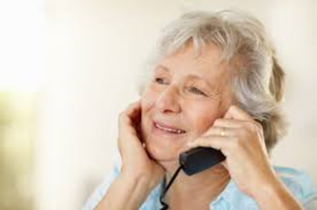
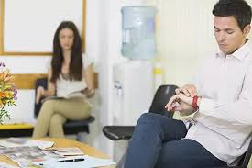
Waiting for your appointment?
Face to Face Appointment
20% of people see the doctor within 10 minutes,
27% saying they might have to wait up to 30 minutes and a further 12% waiting more than 30 minutes
Telephone Appointment
32% of people see the Doctor within 10 minutes, a further
32% have to wait up to 30 minutes, a further
5% are waiting more than 30 minutes
Since 2018, a reduction in the number of people that were told if their appointment was running late (31%, 41% in 2018) versus those that were not told (42%, 48% in 2018)

Slide 9

Your view of the Doctor
75% (83% - 2018 ) reported Very Good/Good at asking about symptoms
65% (80% -2018) reported Very Good/Good at giving you enough time
72% (82% -2018) reported Very Good/Good at listening
65% (77%- 2018) reported Very Good/Good at explaining tests/treatments
60% (69%- 2018) reported Very Good/Good at involving in decisions about care
63% (78%-2018) reported Very Good/Good at treating with care and concern
67% (79%-2018) reported Very Good/Good at taking your problems seriously
Unfortunately, patients’ views of the Doctor has deteriorated since 2018 across all questions

Slide 10
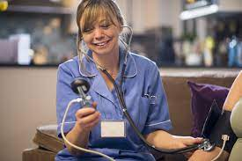
Your view of the Practice Nurse/Advanced Nurse Practitioner
77% (74% - 2018) reported Very Good/Good at asking about symptoms
78% (79% - 2018) reported Very Good/Good at giving you enough time
77% (76% - 2018) reported Very Good/Good at listening
71% (72%- 2018) reported Very Good/Good at explaining tests/treatments
67% (64% -2018) reported Very Good/Good at involving in decisions about care
76% (76%- 2018) reported Very Good/Good at treating with care and concern
74% (75% -2018) reported Very Good/Good at taking your problems seriously
Satisfaction with Practice Nurse/Advanced Nurse Practitioner is improved or broadly similar

Slide 11

Overall, what are you happy with?
66% (69% - 2018) reported Very Satisfied/Satisfied with face-to-face consultations.
  (2023- 13% Dissatisfied/Very Dissatisfied)
50% (47% in 2018) reported Very Satisfied/Satisfied with way in which you are told about test results.
(2023- 11% Dissatisfied/Very Dissatisfied)
58% (38% in 2018) reported Very Satisfied/Satisfied with telephone consultations with the Doctor
(2023 -7% Dissatisfied/Very Dissatisfied)
58% (21% in 2018) reported Very Satisfied/Satisfied with telephone consultations with the Nurse
(2023 - 18% Dissatisfied/Very Dissatisfied)
Improvement in satisfaction with telephone consultations compared to 2018.
Note: for this question, many respondents replied ‘not applicable’

Slide 12

Overall, from survey results what are you unhappy about?
Getting an appointment at the time you wanted it
Perception that Doctors are stressed or not giving you enough time/ listening during consultations
Getting a follow-up appointment with a preferred GP
Not being told if your appointment is running late

Slide 13


What’s Next?

Slide 14

You spoke – we listened!
Survey indicated dissatisfaction with getting appointments and comments re-enforced frustration with inability to ‘book ahead’ when phoning
  Since June 5th – patients can now book up to 7 days in advance by telephone/in person
  (NHS app or Patient Access – patients can still book up to 14 days ahead)
  Early feedback has been positive from both staff and patients!
Text reminders are now sent for GP Appointments
  This has been in place also from June 5th – if Surgery has your mobile phone details!
  Text reminder service is soon to be extended to Nurse appointments
  and blood test appointments.

Slide 15

What you said in the survey you were unhappy about - some solutions
Getting an appointment at the time you wanted it
  From June 5th Appointment can be booked by phone up to 7 days in advance
Perception that Doctors are stressed or not giving you enough time/ listening during consultations
  Practice has now full GP complement and will be less reliant on locums
Getting a follow-up appointment with a preferred GP
  When booking appointments online you can select the GP you wish to see.
  By Phone; ask the receptionist if there are appointments with the GP you wish to see
Not being told if your appointment is running late
  At your appointment, the screen you ‘check-in’ at will advise you if your appointment is on-time. Sometimes as you are waiting, a Doctor may have to leave to attend to an emergency or phone for an ambulance. The reception team will try to advise when this happens, but if you have waited longer than 15 minutes after your appointment time, please check with the receptionist.

Slide 16
Comments
Respondents had an opportunity at the end of the survey to add a comment.
These comments were all reviewed, feedback is provided to the more ‘frequent’ ones
Issue | Feedback
Most frequent concern in the comments Difficulty in getting an appointment | Ability to book appointments up to 7 days ahead is now in place
Other ‘most frequent’ comments
Specific comments overall perception of service from Surgery ‘Amazing’, ’Excellent’, ‘Lucky to have’, ’Helpful’ ‘Poor service’ | Feedback on service (‘friends and family’ test) – now sent by text after an appointment, so patient feelings about service can be regularly reviewed
Perceptions of reduced care from GP- stressed/overworked/lack of empathy/concern re: diagnosis | GP’s always want to give patient appropriate time. As one of the senior partners was off sick for some time, the surgery had to rely on more locums than it would have liked. Recruiting GP’s has been a national challenge, which is now resolved for VSG.

Slide 17

Response from our GP’s
We all share your frustrations about lack of time, and it is disappointing that there is a perception that the Practice is offering a reduced level of care from us, the GPs.
Yes, we are overworked and underfunded, but we are seeing more patients now than we did three years ago, prior to Covid. Delays in referrals to secondary care increase the number of appointments required for the same condition that is awaiting hospital intervention. We became GPs because we want to help people improve their health and wellbeing. If we seem stressed, we are. If it appears we are not interested, then we apologise for that.
We always have been and always will have the aim to provide the best general medical help that we can within the time funded by the NHS.
The single biggest help to us would be: One problem at one appointment. This will assist us in not running late and is much fairer on other patients. We always have and always will give the appropriate amount of time that is clinically required to each patient.

Slide 18
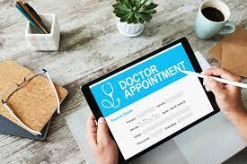
Additional Comments around Appointments
Issue | Feedback
Difficulty Booking GP appointment on line <2 weeks | This can vary. The surgery only has the same number of ‘slots’ for appointments split between on-line and telephone/in person. Being able to ‘book ahead’ by phone up to 7 days in advance may improve on-line availability
Telephone appointments with Dr - Late/need more time/2 hours window not good for workers | In order to provide some flexibility, although you may be given a specific time for your appointment the doctor/nurse could call within 1 hour either side of this. Data suggests in most cases this will be within an hour, but the GP cannot predict what the previous patient will attend with. For workers, evening/Saturday appts. are also available
On-line bookings cancelled by Surgery | This only happens if you have booked something ‘inappropriate’ on line e.g. blood, test, smear, annual review, physio. The surgery will always text you if they cancel an appointment

Slide 19

Comments around Service/Care (1)
Issue | Feedback
Be more pro-active – Contact with test/BP results | Surgery receives over 400 individual test results every day as well as around 12-15 radiology results. To help we have enabled technology so you can see your results on Patient Access/NHS app. The surgery will definitely contact you if your results need to be discussed with you. No news is good news!
Contact after bereavement | In future a GP will contact an immediate family member after an unexpected bereavement
Concern about GP turnover/ability to retain GP’s | On average 71%, of GP sessions have a total of 61 years service with the VSG. 29% have had some degree of 'turnover' including two GPs that felt unable to support the Practice whilst senior partner was off with a serious illness; these 2 GP’s have now been replaced.
Services have improved recently | Thank you for the positive feedback!

Slide 20
Comments around Service/Care (2)
Issue | Feedback
Would like annual check-up/health MOT | Although not our choice, unfortunately NHS do not pay for annual health checks. Anyone over the age of 75 is entitled to an annual health check
Reduction in services disappointing – holiday vaccination/ear syringing | Ear Syringing- National Institute of Clinical Excellence (NICE) does not permit this to be done in primary care any longer. Service can be obtained privately. Holiday Jabs: Better to use these appointments for those who are ill. These were long appointments and requirements in countries changed frequently. Using a travel clinic is better to get the most up to date advice.
Its difficult to get an appointment for a blood test | The surgery will do blood tests but there are only a few appointments available for this which we would prefer to keep for those that are not all that mobile. It is generally quicker to go to the Countess of Chester where they have a dedicated and very efficient clinic specifically for this. Often you can get an appointment within a day or so. Also, it is possible to have a blood test as part of the ‘enhanced access’ service (6.30- 8pm or Saturdays)

Slide 21
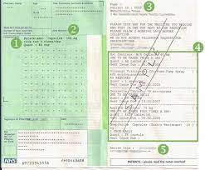
Comments around Prescriptions
Issue | Feedback
Would like ‘comments field’ when ordering repeat prescriptions online | When the comments field was there, if comments were added any repeats ordered on-line would then have to go for GP review instead of automatically being sent to your nominated pharmacy. This caused severe delays. Usually, the comments related to people wanting more medication because of going on holiday. It is possible to order early or if you are planning a very long holiday contact the surgery in advance.
Delays in getting the repeat prescription to the chemist | 4 working days are required from ordering to the prescription being available at your nominated pharmacy. Order early prior to public holidays
Takes a long time to get medication from hospital prescription (pink form) | The hospital prescription itself does say that it may take up to 28 days to get the medication 'translated’ onto the ‘green prescription’/repeat. The surgery needs to do appropriate checks including reading documents from the hospital. Make sure you get enough medication from the hospital pharmacy before leaving to last you.

Slide 22


Comments around Technology
Issue | Feedback
Invest in better telephone system | The surgery now has 16 lines coming into the practice. One system serves both surgeries. The NHS is currently not providing funding to upgrade the phone system
Would like ability to communicate routine requests via email/on- line portal | An on-line portal is available. From the surgery website home page Click ‘E- consult’ icon (shortly to be renamed PatchS)

Slide 23

What the PPG will be doing to help?
Providing additional signposting for help
  e.g. urgent treatment centre,
  Enhanced Access facility
Looking at other topics that could be communicated
  e.g. what to do if you have more than 1 problem you want to discuss with the doctor.
Organising some drop-in sessions for Patient Access/NHS App
  on-line access to book appointments, request repeat Prescriptions and review your medical records
  Dates to be advised- if you are interested, please email vsg.ppg@nhs.net

Slide 24
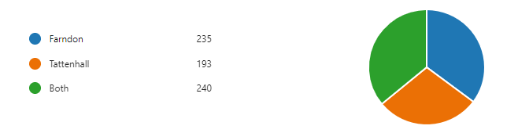
Which Surgery(ies) do you attend?
In 2018, 45% of patients had attended both surgeries
35%
36%
29%
Since 2018, fewer patients attended both surgeries.
New Patients?
174 respondents (26%) had moved to Surgery since previous survey.
Notes:
Lesson descriptions should be brief.

Slide 25
Which devices do you use? More than one response was possible
Many of our oldest patients have access to technology. However, we must remember that not everyone is online.

Slide 26
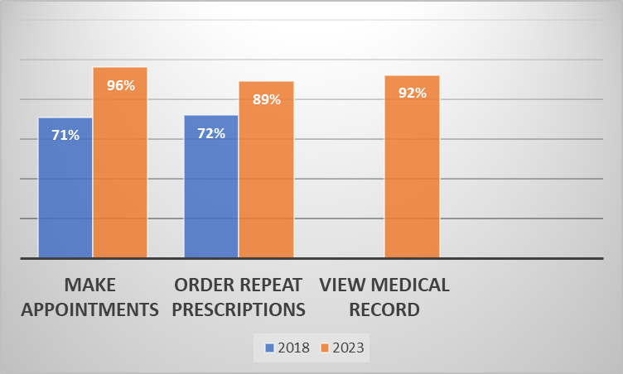
What do you know about On-Line Services?
Improvement in knowledge about
on-line services from around 70% in 2018 to around 90% or greater today
Note: In 2018 it was not possible to view your medical record online
Notes:
Example objectives
At the end of this lesson, you will be able to:
Save files to the team Web server.
Move files to different locations on the team Web server.
Share files on the team Web server.

Slide 27
How satisfied are you with the length of time you had to wait to get an Appointment?
45% of patients are dissatisfied with the time it takes to get an appointment .. this question was not asked in 2018

Slide 28

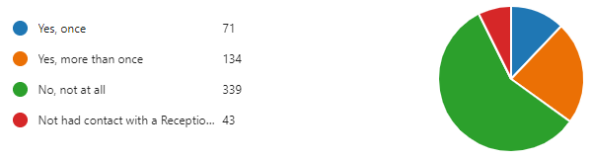
Has a receptionist ever made it difficult for you to see or talk to a GP or health professional?
7%
12%
23%
58%
58% of people said that the reception staff did not make it difficult to see a GP; similar result to 2018

Slide 29
Knowledge of Enhanced Access Service?
Are you aware that it is possible to see a doctor in the wider local area between 6.30pm and 8pm weekdays as well as on a Saturday morning? (enhanced access service)
67% of people are still not aware of the enhanced access service (62% in 2018)

Slide 30
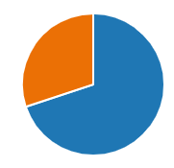

Would you recommend the Surgery?
Fewer people (70%) would recommend the surgery than in 2018 (84%), but still a very positive percentage.
30%
Update: Since June 5th 23, Text ‘Friends and Family’ feedback from 245 patients, has indicated that
221 (90%) would now rate the service as very good (178 pts) or good (43 pts) and thus, if asked, should theoretically recommend the surgery.
No
70%
Yes

Slide 31

PPG Newsletter
87% of people knew about the quarterly digital PPG newsletter
87% of those people read the newsletter
75% of those that read the newsletter find the content useful
As 25% of the patients surveyed didn’t find the newsletter useful. We are asking you to please email vsg.ppg@nhs.net with suggestions what you would like to see in future editions!
The next quarterly PPG Newsletter will be sent in September. If you do not currently receive it and would like to, please contact the Surgery and provide your email address.

Slide 32


Some other comments
Can we understand which nurse specialisms there are so we know who to book with?
Not every nurse is in every day, so depending on your need the reception team will book you in with the most appropriate nurse
Why Does Tattenhall have longer hours than Farndon?
Farndon is a branch site of Tattenhall. The NHS will not pay for Farndon to open for the same hours as Tattenhall. Throughout the UK other branch sites may only open 1-2 days a week
Why are there… no or fewer patients in the waiting room but it is hard to get an appointment?
The new ‘book ahead’ system should make it easier. But there has been an increase in the number of telephone appointments so not all patients now sit in the waiting room
Notes:
So we can improve what we do for the patients and the industry as a whole will be considering a much more patient centric approach.
Here are some ‘hair raising’ comments from patients. !!
Thanks you for everything you do personally to make patients lives better by bringing them more products and better treatments reliably supplied. You are really making a difference and look out for future developments in this space.

Slide 33

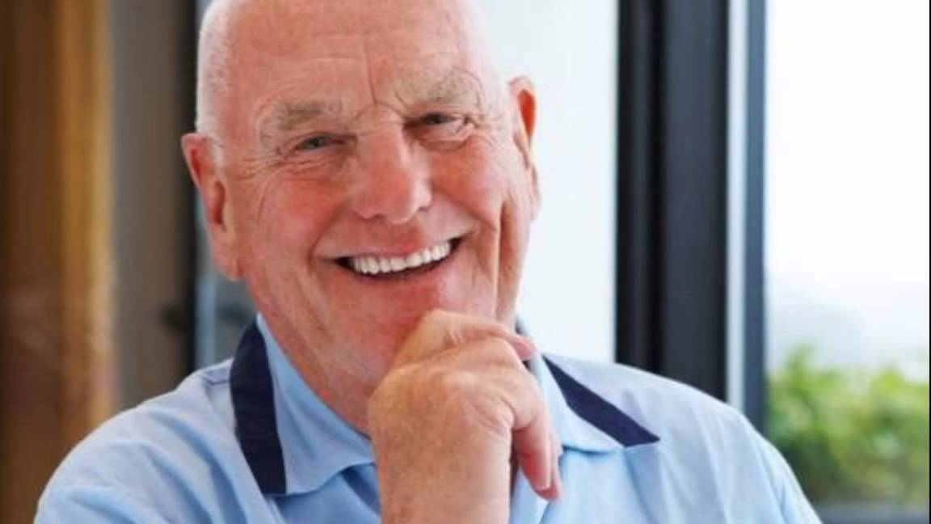
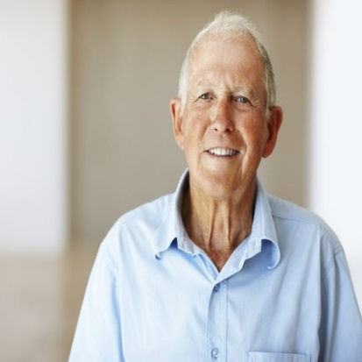
Lastly…Some positive comments
A BIG THANK YOU TO ONE AND ALL, KEEP SMILING!
Excellent care and treatment …just a wee bit difficult to get an appointment.
RECEPTIONISTS ARE FABULOUS AND I AM CONSTANTLY STAGGERED THAT YOU RECEIVE DISCOURTEOUS BEHAVIOUR FROM PATIENTS. ANPs PROVIDE REALLY GREAT CARE AND CAN BE PREFERABLE/ MORE EFFECTIVE THAN SEEING A GP.
THANK YOU FOR YOUR HARD WORK AND CARE
Notes:
So we can improve what we do for the patients and the industry as a whole will be considering a much more patient centric approach.
Here are some ‘hair raising’ comments from patients. !!
Thanks you for everything you do personally to make patients lives better by bringing them more products and better treatments reliably supplied. You are really making a difference and look out for future developments in this space.

Slide 34
If you require more detail/clarification about anything in the slides, feel free to contact the PPG vsg.ppg@nhs.net

